Slide 1
Requesting Letter

Slide 2
March 13
Dear Professor Liu,
I’m very happy to have had attended your lecture on “Linguistics and Language Teaching” last Saturday. Your lecture is quite instructive to my present thesis writing; therefore, I hope I can get your further help. I wonder if it is possible for you to give me a list of reference books on this topic to the following email address: zhang123@yahoo.com.cn. Heartfelt thanks.
Sincerely yours,
Zhang Yue

Slide 3
Content:
1. 陈述请求的理由
2. 发出请求行为
3. 提供请求可能的实现方式
4. 请求的后续行为：致谢

Slide 4
Ask for permission:
a. Would it be possible for me to …?
b. Can I..?
c. Would you mind if I…?
d. I wonder if I could have a few more days.
e. Please give me a few more days.
Re-organize the sentences from the least polite to the most polite. Give your reasons.

Slide 5
Reasons:
Questions are politer than statements. Imperatives are the least polite.
The more indirect and euphemistic, the more polite. (The longer the politer.)
Modal auxiliaries (modal verbs): may/might
can/ could

Slide 6
Ask for help:
Do me a favor, will you?
Would you do me a favor?
Would you be so kind as to…?
Could I trouble you to …?
I wonder if you could …?
I hope this request will not trouble you too much.
If it is not too troublesome, could/would you…?

Slide 7
More examples:
Let’s go to the bookstore this afternoon.
I want to have a look at your book.
I wish you could…
I would like to …
The room is in a mess. We haven’t cleaned it for several days.
I feel a bit hungry now. What time is it?

Slide 8
How polite you should be depends on:
The relationship with your addressee
The degree of difficulty of the request

Slide 9
Extension Work 10’
Situation：国外某著名教授上周来你校作讲座，你因故迟到了，耽误了一半讲座，也没有拿到讲座的讲义。但是这个讲座对你很有帮助。请你给这位教授写封Email索要一份这次讲座的讲义。
作业要求：
1.按照课上讲授的写作思路为以上场景写一封email(1st draft)；
2.用AI批改，指出文中错误 (格式、内容、语言、得体性等),对于AI指出的问题进行独立思考后修改，并对照AI的修改建议；
3.结合AI建议修改后提交1st draft(5分), 对于AI revision的思考(2分) ，final draft(3分)

Slide 10
AI Revision Prompt 1
AI Revision Prompt 2

Slide 11
September 25
Dear Professor Hu,
Your lecture on “American Literature” is really instructive for my English study. But it is a pity that I was late that day due to a minor accident on my way to the lecture, missed the first half of the lecture, and failed to get the handout. I wonder if it is possible for me to get the handout. If it is possible, would you please email it to the address: zhang123@yahoo.com or call me at 13112345678 and I will go fetch it. Heartfelt thanks.
Respectfully yours,
Zhang Yun

Slide 12
Dear Ms. Roberts:
Subject: Letter of recommendation for Eric Laurence
It’s with great pleasure that I write this letter on behalf of Eric Laurence. He was employed by me as a Contracts Manager for five years and left to pursue his Master’s degree full time. We told Eric that the position would be waiting for him when he finished, but he now wants to pursue opportunities with a larger company.
I’m enclosing a copy of an award Eric received while he was with us. Eric is a person of the highest integrity, who works efficiently and tirelessly to get the job done. He’s creative and delightful to work with. You’d be most fortunate to have him join your staff.

Slide 13
Complaint Letter
1. 写信给plaza 经理，投诉上周五1月5日晚上8点左右你在plaza遇到一位女售货员拒绝你试衣服请求的问题。
2. 谴责她粗鲁的态度，并敦促经理要求这位售货员做出当面道歉。
3. 提供你的联系方式。

Slide 14
Jan. 8, 2025
Dear Mr. Smith,
I am writing to complain about the rude behavior of one saleslady in your plaza. On last Friday, Jan. 5, around 8 o'clock, my friend and I were shopping in your plaza. Unfortunately, we were treated very rudely by the salesgirl of ABC. This arrogant saleslady refused us when we asked to try on one dress, claiming that we could try on only after we pay for it.
This kind of behavior is inexcusable, and an unpleasant surprise from plaza like yours. I would like a sincere apology from this saleslady, but you do whatever you feel is necessary. Keep in mind, however, that your actions will demonstrate how much you value my continued business.
My cell phone number is 9095555555. I look forward to your reply.
Yours sincerely,
Lucy Moore

Slide 15
Content:
1. 抱怨投诉行为
2. 内容具体描述
3. 要求弥补,纠正,赔偿
4. 敦促或威胁

Slide 16
1. 抱怨投诉行为
I'm sorry. I can't bear the noise any more.
I'm writing to complain about
I'm writing to report the problems with your…
I'm writing to bring your attention to the problems I have had with your…

Slide 17
2. 内容具体描述
Here's the problem I've had…

Slide 18
3. 要求弥补,纠正,赔偿
I hope you can address this problem soon.
I hope you will take steps to rectify this situation soon.
Would you please turn it down a little?
It would be very kind (considerate) of you to…

Slide 19
4. 敦促或威胁
Frankly, I am not willing to put up with the situation any more.
You must rectify the situation, or I will take it to the court.
If you can't give me a satisfactory answer, I will complain it to the Consumer Association.

Slide 20
Extension Work 10’
1.写一封email给某网站客服
2.投诉你收到的货品破损的情况
3.提供快递破损证明并要求退款
作业要求：
1.按照课上讲授的写作思路写一封投诉信
2.让AI批改，指出文中错误 (格式、内容、语言等)并给出修改建议
3.根据AI建议修改后提交1st draft(5分), AI revision(2分) ，final draft(3分)

Slide 21
Itinerary(旅行日程) & Travel Guide

Slide 22
Itinerary
an established line of travel or access
a guidebook for travelers
a proposed route of travel
It includes the advice on what to see and do,
maps, city guides, local transportation, local
customs and festivals, etc

Slide 23
Useful Expressions
1. 每日行程安排：
day by day itineraries
2. 报价包含
price inclusion
3. 报价不含
price exclusion
4. 发车日期
departure date
5. 经济游\豪华游
budget tour\ deluxe tour
6. 住宿
accommodation
7. 淡季\旺季
low season\high season
8. 协议条款\合同条款
terms and conditions

Slide 24
Useful Expressions and Sentence Patterns
旅游景点介绍，如历史文化背景， 特产等
1.本次旅程将带您到中国的一些偏远地区。
This tour takes you to the very remote parts
of China.
2.这是中国传统文化的象征。
That is the symbol of traditional Chinese
culture.
3.本次文化之旅的亮点是去探索有千年历史的南浔
古镇。
The highlight of this culture travel route is to
explore the Ancient Town of Nan Xun.

Slide 25
每日行程安排及所包含服务项目
4.报价包含：全程独立旅游车交通费、门票及导游费用。
The price includes all transfer with private vehicle, entrance fees and tour guide.
5.以上报价基于至少两位游客，单个游客请再付95美元，六人以上游客请发e-mail给我们以咨询新的报价。
The price above is based on minimum two travelers. For single person, please pay extra $95. For a group of over 6 people, please email us for a new quotation.
6.提前付款
Payment in advance.

Slide 26
7. 导游将在机场接你们，然后到酒店。
You are greeted by your guide at the airport and transferred to the hotel.
8.优惠条款：八人以上打八折。
Bonuses info: 20% off for a group of 8 people and above.

Slide 27
 | Destination | Accommodation | Free services and possible charges
Day 1 | England | / | Free meal, drinks, and in-flight entertainment
Day 2 | London | Central Park Hotel | Breakfast. An optional transfer $ 42 ( or from London Gatwick $ 53)
Day 3 | London | Central Park Hotel | Breakfast. Shakespeare's Globe Theatre ($67) Wallace Plaque

Slide 28

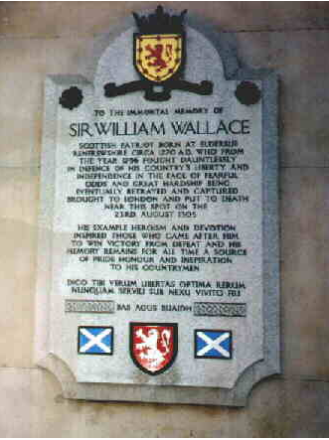
William Wallace was a Scottish knight who became one of the main leaders during the Wars of Scottish Independence. He is the hero of the movie Braveheart .

Slide 29
Day 4 | Netherlands | NH Central Station | Breakfast. Optional transfer for $42 ($53 to Gatwick) for your flight to Amsterdam. A Transfer from the airport to your hotel is available for $41
Day 5 | Amsterdam | NH Central Station | Breakfast. Historic homes, 16th-century warehouse and churches ($31)
Day 6 | Amsterdam | NH Central Station | Breakfast. Visit a cheese farm before returning through the countryside to Amsterdam ($36)
Day 7 | U.S.A | / | Breakfast. Optional transfer ($$41)

Slide 30
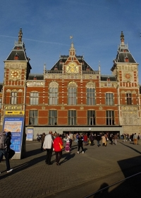
NH Central Station

Slide 31
Date | Sites | Stay at | Travel by
2017.7.15 | Hangzhou-Vancouver 11:05- 11:10Vancouver -Ottawa | Courtyard Ottawa East 200 Coventry Road, K1K 4S3 Ottawa | Flight CA 1510/991
7.15-7.17 | Ottawa | Courtyard Ottawa East 200 Coventry Road, K1K 4S3 Ottawa | car
7.18 | Ottawa-2h-Kingston | Residence Inn by Marriott Kingston Water's Edge 7 Earl Street,Kingston , K7L 0A4 | car
7.19 | Kingston-2.5h-Toronto-1.5h-Nigara Fall | Hilton Hotel and Suites Niagara Falls/Fallsview 6361 Fallsview BoulevardNiagara Falls, L2G 3V9 | car
7.20 | Toronto | Residence Inn by Marriott Toronto Airport 17 Reading Court Etobicoke Toronto , M9W 7K7 | car
7.21 | Toronto-CalgaryCrossIron Mills shopping | Lakeview Signature Inn 2622 39th Avenue Northeast, T1Y 7J9 14037353336 | Flight
7.22-7.24 | Calgary-1A-(Canmore)-banff-Lake louise | Lake Louise Inn 210 Village Road PO BOX 209, Lake Louise, T0L 1E0 | car
7.25 | Lake Louise-(232km)3h-Jasper | Dave & Honey's Accommodation 804 Turret Street, T0E 1E0 ，Jasper 1780852727 | car
7.26 | Jasper-(321km)4h- Golden | Kapristo Lodge 1297 Campbell Road, V0A 1H7 12503446048 | car
7.27 | Golden-Vancouver | Robson Suites 777 Bidwell Street, V6G 3B9 +16046859777 | car
7.28-8.1 | Vancouver | Robson Suites 777 Bidwell Street, V6G 3B9 +16046859777 | car
8.2 | Vancouver-Hangzhou10:40-18:30 |  | FlightCA998/1563

Slide 32
Homework: Write a tourists’ guide by translating the following information.
北京豪华3日游 报价：RMB 2800
出发时间：每天
行程安排：第一天：天坛---天安门广场---故宫---北海
第二天：颐和园---圆明园
第三天：长城---十三陵
报价包含服务：
1. 免费从机场、车站接送至酒店，以及全程景点的旅游车接送服务
2. 5星级住宿
3. 一日三餐
4. 所有门票

Slide 33
Luxury Tour 3 Days of Beijing
Quotation: 2800
Departure Time: Daily
Day by day itineraries:
Day 1 Temple of Heaven-Tian’anmen Square-The Imperial Palace-Beihai Park
Day 2 Summer Palace-Yuan Ming Yuan Garden
Day 3 Great Wall-Ming Tombs
Price Inclusion:
Free transfer from the airport and stations to the hotel and to all scenery spots with private van
Accommodation: 5 star hotels
Three meals a day

Slide 34
Preparation
www.baidu.com
www.wikipedia.org
www.mafengwo.cn
www.eueueu.com

Slide 35
Booking
www.qunaer.com
www.skyscanner.com
www.airasia.com
www.airasiago.com

Slide 36
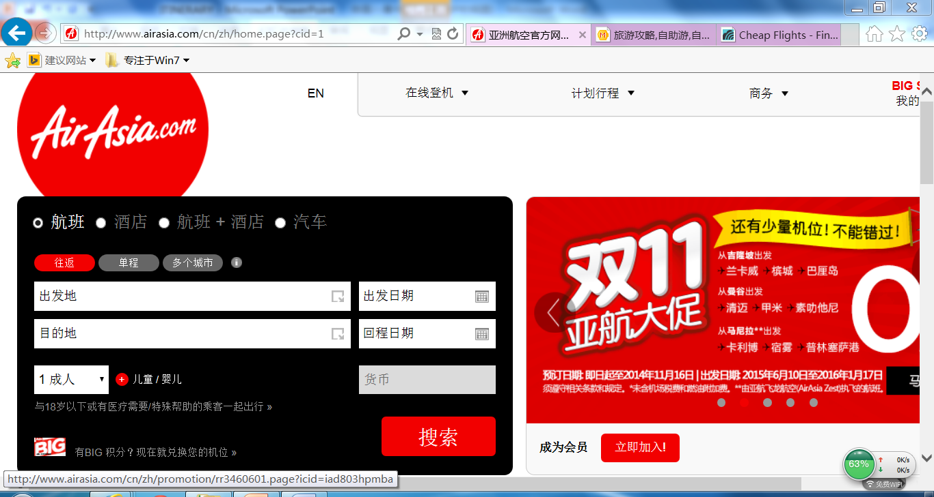
www.airasia.com

Slide 37
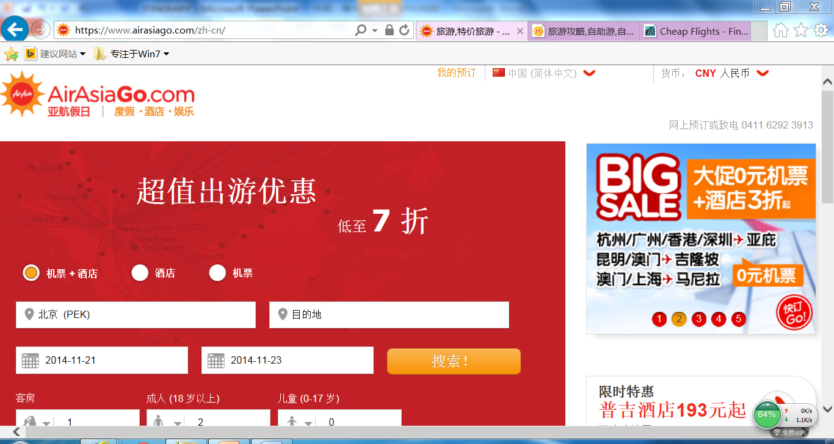
www.airasiago.com

Slide 38
Booking
www.ctrip.com
www.agoda.com
www.booking.com

Slide 39
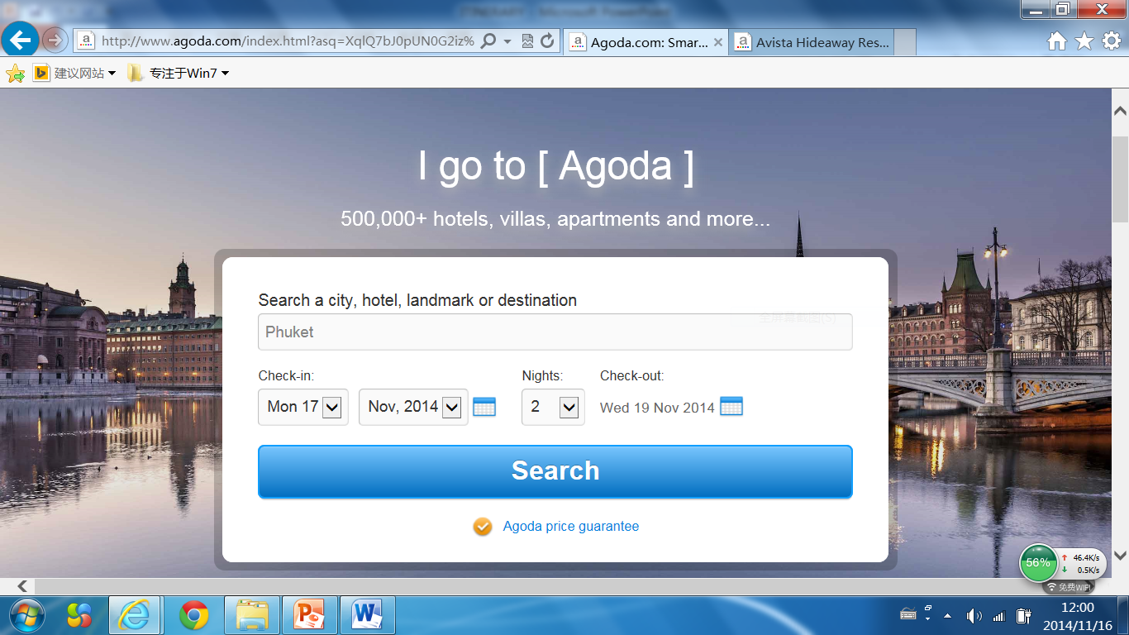
www.agoda.com

Slide 40
Getting Ready to Go
Passport
Visa
Arrival/Departure Card
Customs Declaration Form

Slide 41
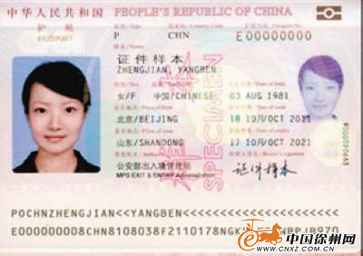
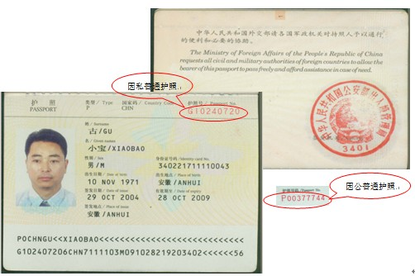

Slide 42
Arrival Card
1. Family Name 姓
2. First (Given) Name 名 |  |  |  |  |  |  |  |  |  |  |  |  | 3. Birth Date (day/mo/yr) 出生日期（日/月/年）
4. Country of Citizenship 国籍 |  |  |  |  |  |  |  |  |  |  |  |  | 5.Sex (Male or Female) 性别（男或女）
6.Passport Number 护照号 |  |  |  |  |  |  |  |  |  |  |  |  | 7.Airline and Flight Number 航班号NumberHANG航班号
8.Country Where You Live居住的国家 |  |  |  |  |  |  |  |  |  | 9.City Where You Boarded居住的城市
10.City Where Visa Was Issued获得签证的城市 |  |  |  |  |  |  |  |  |  |  |  |  | 11.Date Issued (day/mo/yr) 签证日期（日/月/年）
12.Address While in the United States (Number and Street)在美地址（含街道和门牌号）
13.City and State（上述地址所在）城市和州

Slide 43
Departure Card
1. Family Name 姓
2. First (Gicen) Name 名 |  |  |  |  |  |  |  |  |  |  |  |  |  |  |  |  |  |  |  |  | 3. Birth Date (day/mo/yr) 出生日期（日/月/年）
4. Country of Citizenship 国籍

Slide 44
Arrival Card and Customs Declaration

Slide 45
Arrival card of some other countries

Slide 46
Groupwork
Pick a destination.
Write an itinerary.
Make up your travel story to provide more information, e.g. passport etc.
Exchange your stories and fill in the forms.

